Slide 1
Course Title
Entrepreneurship Development in Bangladesh
Course Code-BUS-341
Dr. Md Zillur Rahman
Associate Professor
Dept. of Business Administration
SUST, Sylhet

Slide 2
Lecture-2
Topics
Concept of Startup
Startup in Bangladesh

Slide 3
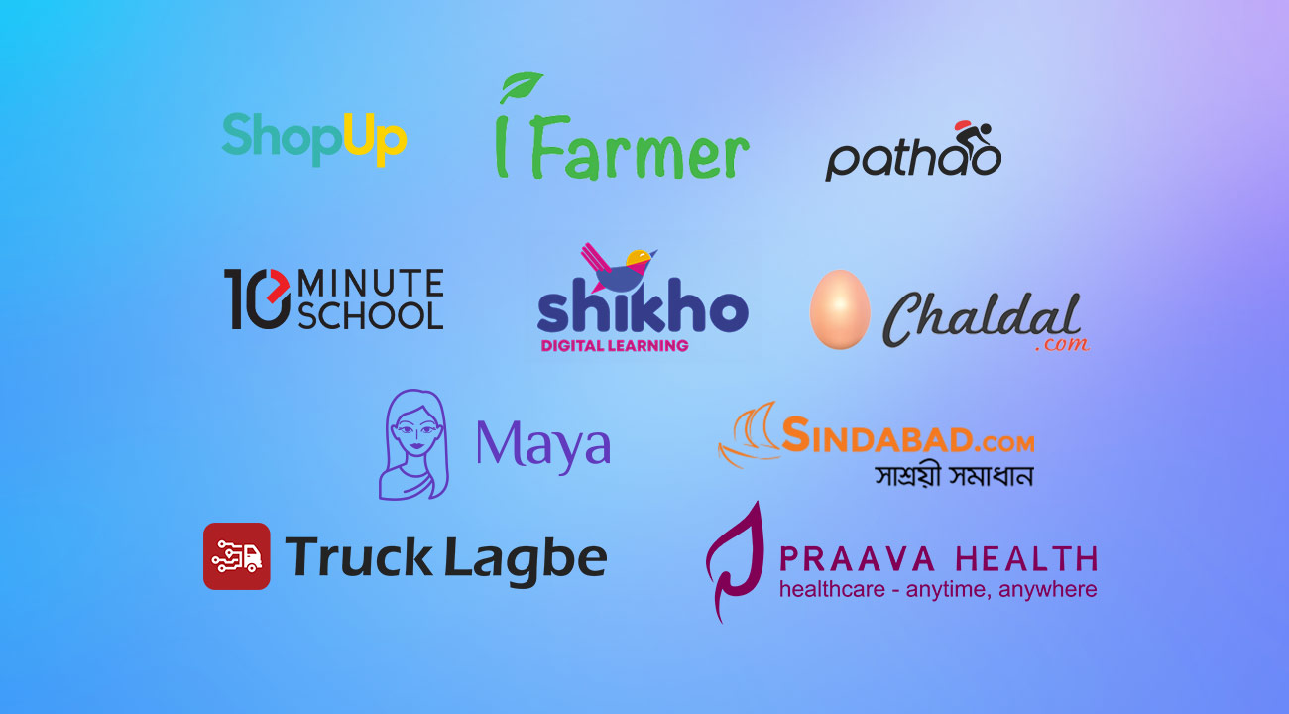
A startup is a young, innovative company designed to grow quickly by offering a unique product, service, or platform to address a specific problem in the market.

Slide 4
Key Characteristics of Startup
Startups are characterized by innovation, growth potential, scalability, and a high-risk, high-reward mindset.
A startup is a company that's in the initial stages of business.
Founders normally finance their startups and may attempt to attract outside investment before they get off the ground.
Funding sources include family and friends, angel investors, venture capitalists, crowdfunding, and loans.
Startups must also consider their legal structure and where they'll do business.
Startups come with a high risk of failure, but they can also be unique places to work with good benefits, a focus on innovation, and great opportunities to learn.

Slide 5
Current State of Startups in Bangladesh
Over 1,200 startups operate in Bangladesh across sectors like fintech, e-commerce, health-tech, agritech, and logistics.
Dhaka is the central hub for most startups.
The government launched the Startup Bangladesh Initiative to support and fund startup growth.

Slide 6
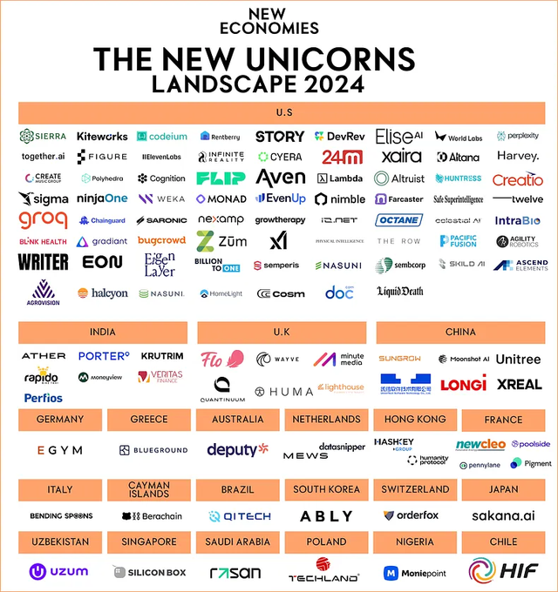
Unicorn: The term unicorn refers to a privately held startup company with a value of over $1 billion. The term was first published in 2013, coined by venture capitalist Aileen Lee.

Slide 7
Types of startups
Lifestyle startups
Small business startups
Scalable startups
Buyable startups
Large company Startups
Social startups
Fintech startups

Slide 8
Lifestyle Startups
People who have hobbies and are eager to work on their passion can create a lifestyle startup. They can make a living by doing what they love. We can see a lot of examples of lifestyle startups. Let’s take dancers, for instance. They actively open online dance schools to teach children and adults to dance and earn money this way.
Some examples of Lifestyle startups are freelancing graphic designers, web designers, travel bloggers, coders, etc.

Slide 9
Small Business startups
Entrepreneurs who start small businesses want to build a long-lasting and sustainable business rather than earn huge profits or scale up. They run their business to feed their families and live comfortably with family and friends.
Travel agents, bakers, plumbers, grocery store owners, and carpenters usually commence this startup. Since it is a small business startup, they don’t need a business-facing app but a responsive specialized app that can navigate, order and track the products/services a customer may want.

Slide 10
Scalable Startup
Companies in a tech niche often belong to this group. Since technology companies often have great potential, they can easily access the global market. Tech businesses can receive financial support from investors and grow into international companies.
Examples of such startups include Google, Uber, Facebook, and Twitter. These startups hire the best workers and search for investors to boost the development of their ideas and scale.

Slide 11
Buyable Startup
Technology- and software-based startups make up the majority of buyable startups. They are typically web- and app-based startups. The main aim of such startups is not to grow or build a billion-dollar business but to sell to larger companies in exchange for a hefty profit.
Entrepreneurs of buyable startups should have startup ideas with enormous growth potential. They are always trying to raise money for their start-ups by opting for crowdfunding and angel funding.

Slide 12


Social startups
These startups aim to make the world a better place to live. They are less passionate and ambitious about earning profits when compared to other founders. In short, they provide donations, grants, and charities to build positive social and environmental change worldwide.
Examples include charities and non-profit organizations that exist thanks to donations. For instance, Code.org, a non-profit organization, encourages school students in the US to learn computer science.

Slide 13
Fintech startups
Fintech (financial technology) startups innovate in the financial sector, offering digital solutions to traditional financial services. They leverage technology to improve efficiency, accessibility, and user experience in payments, lending, wealth management, or cryptocurrencies. Examples include online payment platforms, robo-advisors, or peer-to-peer lending platforms.

Slide 14
Why do startups fail?
1. Lack of Market Demand
The product or service doesn’t solve a real problem.
There’s insufficient market research to validate demand.
2. Running Out of Cash
Poor financial management.
Underestimating costs or overestimating revenue.
Failure to secure follow-on funding.
3. Poor Team Dynamics
Lack of experience or expertise in critical areas.
Poor team chemistry or internal conflicts.
Inability to hire and retain key talent.
4. Weak Business Model
No clear path to profitability.
Over-reliance on a single revenue stream.
Misunderstanding customer acquisition and retention.

Slide 15
Why do startups fail?
9. Founder Burnout or Lack of Focus
Overworking leads to poor decision-making.
Shifting focus away from core objectives.
10. Legal and Regulatory Challenges
Legal disputes.
Regulatory hurdles or compliance issues.
11. Ignoring Customer Feedback
Failure to adapt based on customer insights.
Building features customers don’t want.
5. Product Problems
Poor product-market fit.
Low-quality product.
Failure to iterate based on user feedback.
6. Ineffective Marketing
Failure to reach or resonate with the target audience.
Inadequate marketing strategy or execution.
7. Competition
Underestimating competitors.
Losing market share to a better or faster-moving competitor.
8. Poor Timing
Launching too early or too late.
Market not being ready for the product.

Slide 16
Reverse the failure of startups
Diagnose the Problem Honestly
Pivot Your Business Model
Secure Financial Lifelines
Reconnect with Customers
Improve the Product or Service
Restructure the Team
Reassess the Market Fit
Plan a Relaunch Strategy
Build a Resilient Mindset
Know When to Move On

Slide 17
Building a Startup from Scratch
Find a good idea
Develop a business plan
Ensure you have adequate capital
Choose the right people
Pick a location and design a site
Learn how to leverage digital marketing techniques
Create your customer base

Slide 18
Building a Startup from Scratch
Find a good idea. To be successful, entrepreneurs search for products and services that are in great demand among customers. Analyze the demand, customers' needs and wants, and make sure that people actually need your product. You should also figure out whether your product will be able to attain at least ten clients. This will help you decide which product you want to create and in which direction to move. However, before putting your idea into practice, do your market research and analyze your competitors.
Develop a business plan. Having an idea isn’t enough since the process also requires a business plan. A business plan is a document that contains a company’s objectives and ways to achieve its goals. It also includes a description of the business future and an outline of business strategy. Statistics show that people with a plan succeeded in obtaining investment capital and growing their startups.
Ensure you have adequate capital. There’s no definite amount of money you need to start a business since the costs of a startup vary from one industry to another. Depending on the type of business and the situation, you’ll need more or less funding. Some small startups without equipment and employee salaries might cost you approximately $10,000, while other ventures might cost millions. The main source of financing is usually the entrepreneur’s savings.

Slide 19
Building a Startup from Scratch
4. Choose the right people. You can’t disagree with the fact that to solve all issues you need some additional help. However, remember to choose people whom you trust wisely. You’ll need some employees and a manager to run a company. The number of workers depends on the industry you are in and how big your business is. Based on statistics, startups are small companies that have small teams. In general, startups consist of up to ten employees.
5. Pick a location and design a site. You need to have a physical and a web address so that customers can easily find your company. Consider buying or leasing a property to operate your business. Although purchasing it is significantly cheaper in the long run, you need to ensure you have enough costs. This way, you’ll save funds and have a good investment in your future beginnings. Design a site to promote your startup, take some pre-orders, and schedule possible appointments. Online presence is a must because it helps reach your target audience faster, promote products, and generate profit.
6. Learn how to leverage digital marketing techniques. You can have a great product, but you won’t be able to promote it without various marketing techniques. Consider the following marketing strategies: SEO, content marketing, social media marketing, email marketing, and PPC.
7. Create your customer base. After developing a site, growing your digital presence, and becoming a good marketer, it’s time to build a customer base. Create a convenient website to provide your consumers with a seamless experience and encourage them to come back. To get repeat customers, you need to provide high-quality products and excellent customer service. Your clients are your main priority, so treat them accordingly.

